Slide 1

REQUest for the first amendment to the Newfield Development agreement
Board of County Commissioners
June 23, 2026

Slide 2
Newfield Project History
August 18, 2018
  CPA 18-04: Created the Mixed-Use Village (MUV) land use, specific to the Newfield Development
  CPA 18-03: Assigned MUV land use to the 3,400 acres
September 11, 2018
  Ordinance 1083: Created Article 11, Land Development Regulations, Planned Mixed-Use Village (PMUV), form based code consistent with the MUV land use
December 15, 2020
  Development Agreement was approved between Master Developer and Martin County BOCC
  Crossroads Master Plan approved
  Newfield Community Develop District (CDD) was approved

Slide 3
Newfield History continued
Conservation Easements
SD-W Workplace Master Plan
Trail heads
Soccer fields complex
Parks Master plan
Numerous site plans and plats

Slide 4
Development Agreement
Staff initiated amendment pursuant to Article 7,
LDRs and State Statute
Requires 2 public hearings
Proposed amendment to Section:
7.0.B. OpenSpace/ Conservation Lands

Slide 5
Newfield Open Space/Conservation Lands
MASTER DEVELOPER shall identify 125 acres to be used by COUNTY for environmental purposes, including but not limited to the placement, storage, grading, and management of excavated materials such as muck, soils, sediments, and related byproducts (“Environmental Parcel”).
The 125 acres was previously relegated to a Storm Water Treatment Area
40% of impact fees are credited to Developer to establish trailheads
60% of impact fees are credited to Developer for the 125 acres

Slide 6
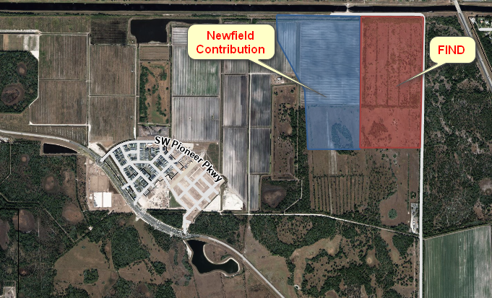
Newfield Open Space/Conservation Lands

Slide 7
Recommendation
Move that the Board receive and file the agenda item and its attachments as exhibit 1
Move that the Board approve the Development Agreement Amendment for the Newfield project

